Slide 1
Backtracking
Notes:
‹#›

Slide 2
A short list of categories
Algorithm types we will consider include:
Simple recursive algorithms
Backtracking algorithms
Divide and conquer algorithms
Dynamic programming algorithms
Greedy algorithms
Branch and bound algorithms
Brute force algorithms
Randomized algorithms
‹#›
Notes:
‹#›

Slide 3
Backtracking
Suppose you have to make a series of decisions, among various choices, where
You don’t have enough information to know what to choose
Each decision leads to a new set of choices
Some sequence of choices (possibly more than one) may be a solution to your problem
Backtracking is a methodical way of trying out various sequences of decisions, until you find one that “works”
‹#›
Notes:
‹#›

Slide 4
Solving a maze
Given a maze, find a path from start to finish
At each intersection, you have to decide between three or fewer choices:
Go straight
Go left
Go right
You don’t have enough information to choose correctly
Each choice leads to another set of choices
One or more sequences of choices may (or may not) lead to a solution
Many types of maze problem can be solved with backtracking
‹#›
Notes:
‹#›

Slide 5
Coloring a map
You wish to color a map with not more than four colors
red, yellow, green, blue
Adjacent countries must be in different colors
You don’t have enough information to choose colors
Each choice leads to another set of choices
One or more sequences of choices may (or may not) lead to a solution
Many coloring problems can be solved with backtracking
‹#›
Notes:
‹#›

Slide 6
Solving a puzzle
In this puzzle, all holes but one are filled with white pegs
You can jump over one peg with another
Jumped pegs are removed
The object is to remove all but the last peg
You don’t have enough information to jump correctly
Each choice leads to another set of choices
One or more sequences of choices may (or may not) lead to a solution
Many kinds of puzzle can be solved with backtracking
‹#›
Notes:
‹#›

Slide 7
Backtracking (animation)
dead end
?
dead end
dead end
?
start
?
?
dead end
dead end
?
success!
‹#›
Notes:
‹#›

Slide 8
The backtracking algorithm
Backtracking is really quite simple--we “explore” each node, as follows:
To “explore” node N:
1. If N is a goal node, return “success”
2. If N is a leaf node, return “failure”
3. For each child C of N,
3.1. Explore C
3.1.1. If C was successful, return “success”
4. Return “failure”
‹#›
Notes:
‹#›

Slide 9
N – queens Problem
‹#›

Slide 10
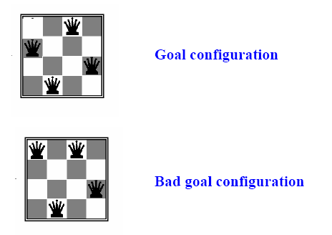
N-queens problem
Find a configuration of n queens not attacking each other

Slide 11
Try
What is the maximum number of queens that can be placed on an n x n chessboard such that no two attack one another?
The answer is n queens, which gives eight queens for the usual 8x8 board

Slide 12
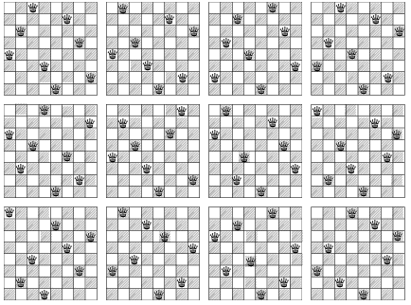
12 Unique Solutions : 8-Queens Problem

Slide 13
8-Queens Problem
There are 92 distinct solutions
There are 12 unique solutions discounting symmetrical answers ( rotations / reflections)
How many solutions for 4-Queens? N-Queens?

Slide 14
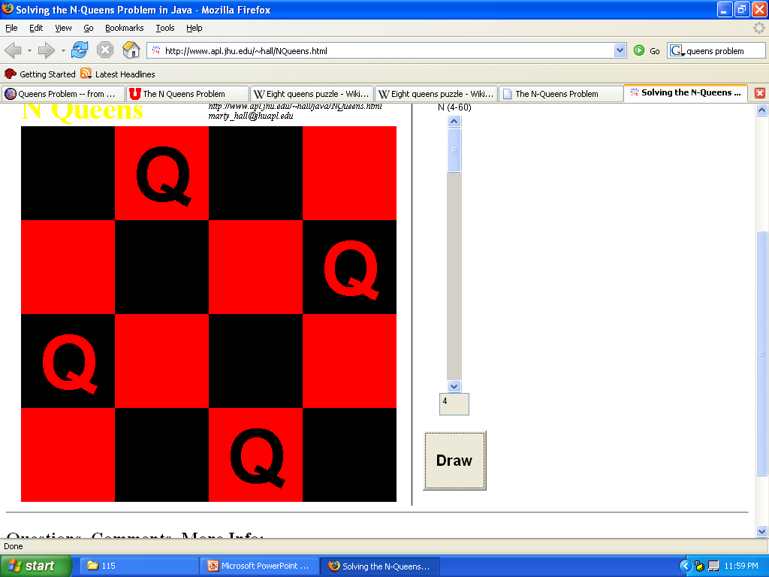
Problems N < 4
N < 4
Cannot use N Queens
3
2
1

Slide 15
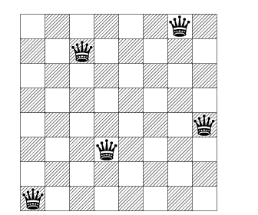
Try
What is the minimum number of queens needed to occupy or attack all squares of an 8x8 board?

Slide 16
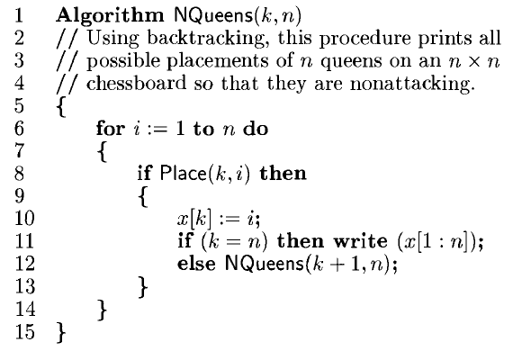
Algorithm
‹#›

Slide 17
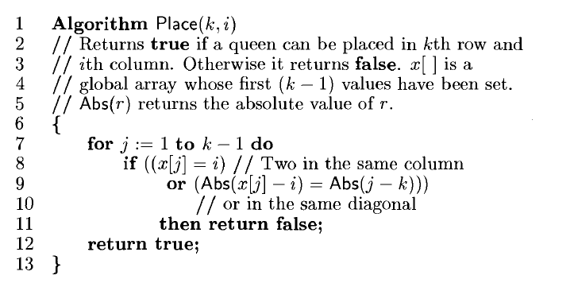
Algorithm
‹#›

Slide 18
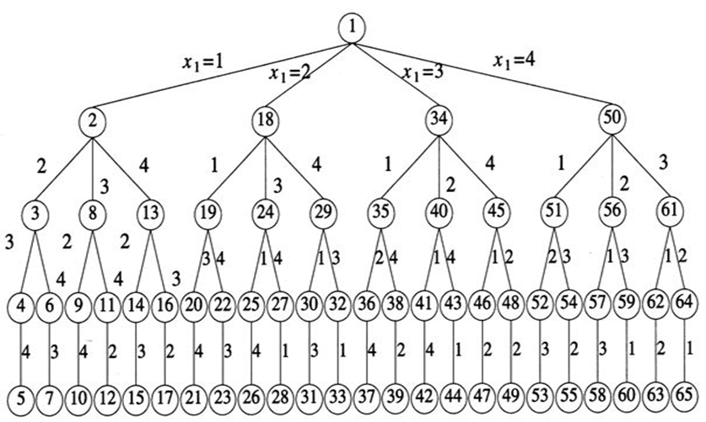
State Space Tree of 4-Queens Problem
‹#›

Slide 19
Complexity Analysis
At each level, branching factor decreases by 1 & it creates a new problem of size (n-1).
With n choices it creates n different problem of size (n-1) at level 1.
PLACE function determines the position of the queen in O(n) time.
Thus the recurrence of n-Queen problem is defined as
T(n) = n T(n-1) + n²
Solution to the above recurrence would be O(n!).
‹#›

